Slide 1
CAR AUTOMATION
Supervised By:
Dr. Abd El-Rahman Tamem, Dr. Eman Salah
Directed By:
Mahmoud Gamal Ramadan – 20269
Ahmed Hany El-Ghonamy Abd El-Hamid - 21663

Slide 2

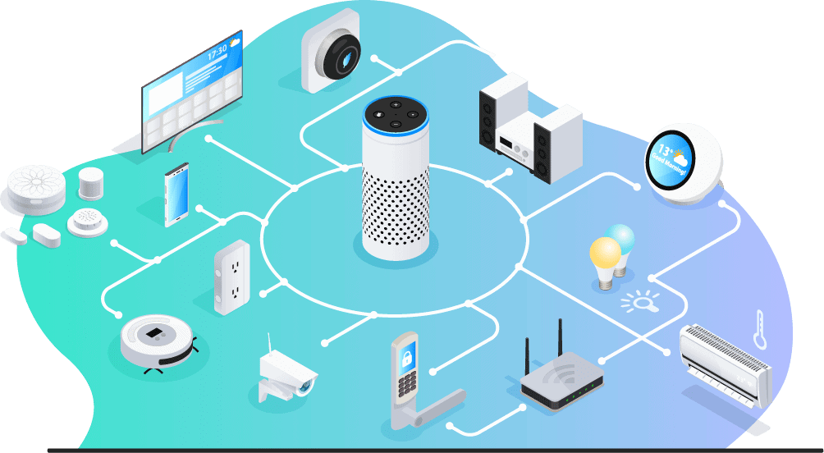
overview
At the new edge that we are living in we can’t imagine our regular days without help of automation, almost all new industries using automated machines, navigation of ships, auto pilot, GPS and lastly smart homes.
The main conclusion that you are using automated devices everyday.
Our project aims implement automation by following specific human (Owner) by using two systems
1. Computer Vision
2. Embedded Systems

Slide 3
Targeted points
How we ACHIEVE the points?
Detect human’s Face
Detect human body
Recognize owners of the car
Direct car to the owner position
Full Body Detection
Face Detection
Collect Owner Data
Comparison Between Detected Objects and Owner’s Data
Struct Main Movement’s of The Car
Real Time Execution for Critical Actions
Direct Car to Position of Owner

Slide 4
Required components
Mechanical Component
Car Body (3D-Printing)
Wheels
Shafts
Electrical Components
Raspberry Pi 4
ATmega32
USBasp
Raspberry Pi Camera
PCB
Male-Female Connection Caples
DC-Motors
LM 298N

Slide 5
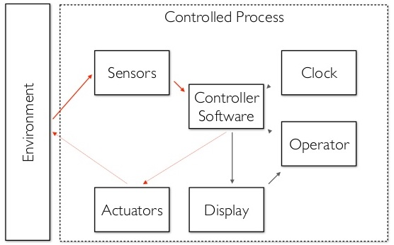
What is an embedded systems?
An embedded system is a microprocessor-based computer hardware system with software that is designed to perform a customized function, either as an independent system or as a part of a large system.
Complexities range from a single microcontroller to a suite of processors with connected peripherals and networks, from no user interface to complex graphical user interfaces. The complexity of an embedded system varies significantly depending on the task for which it is designed.
Embedded system applications range from digital watches and microwaves to hybrid vehicles and cell phones. As much as 98 percent of all microprocessors manufactured are used in embedded systems.

Slide 6

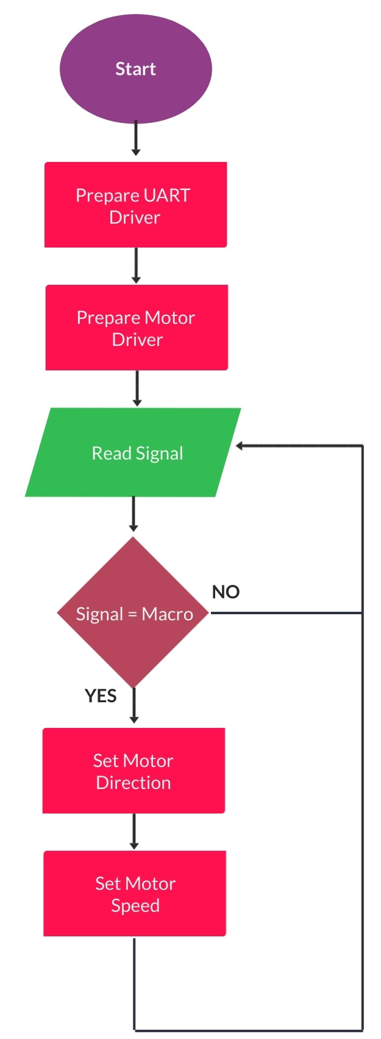
Embedded SYSTEMS FLOWCHART

Slide 7
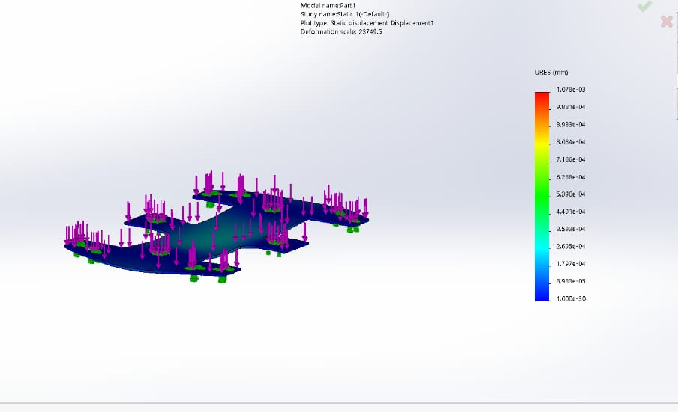
Mechanical Design
We design the body and the chasses of the car using 3D printer machine, in addition to the calculations of the stresses and strain upon the chasses and the wheels.

Slide 8
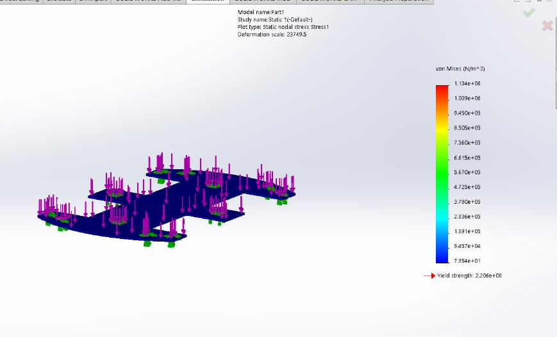

Slide 9
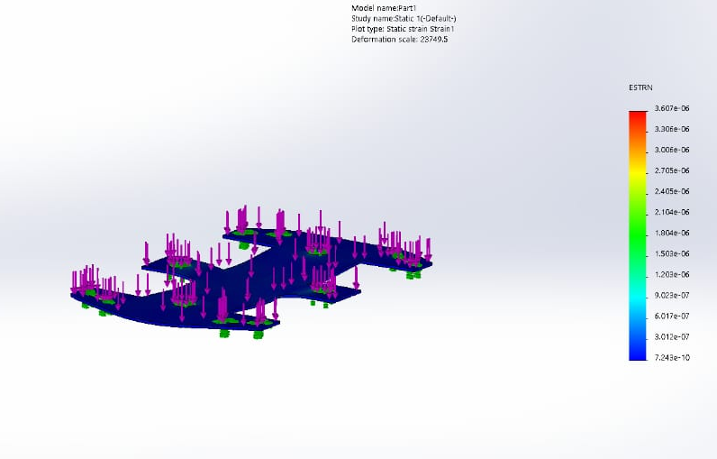

Slide 10
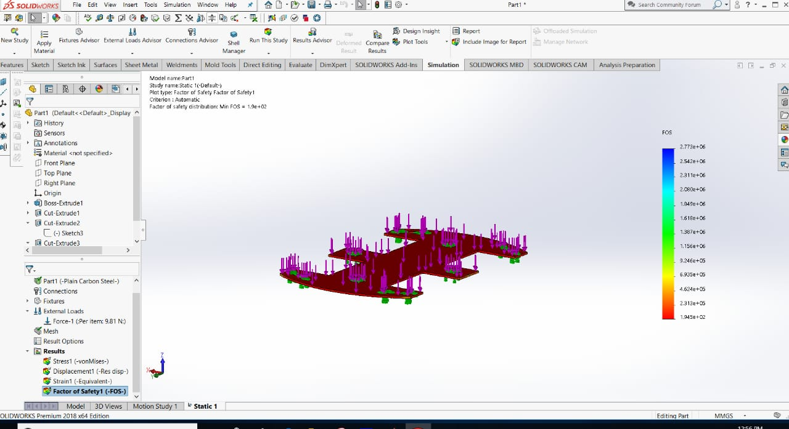

Slide 11
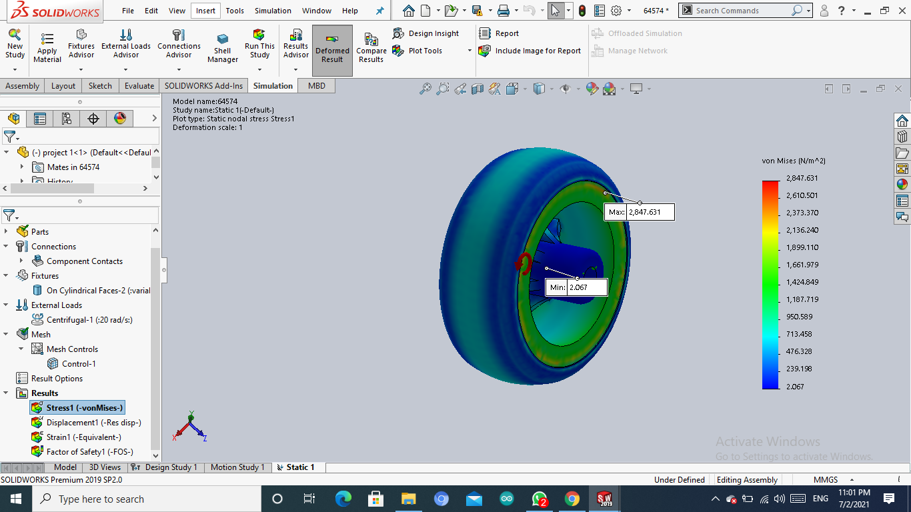
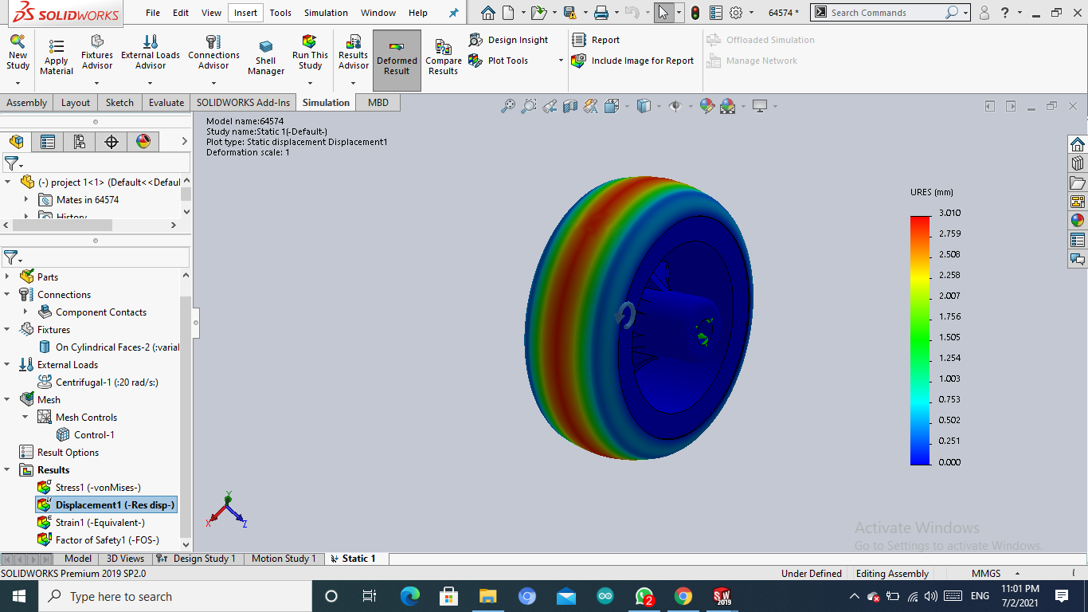
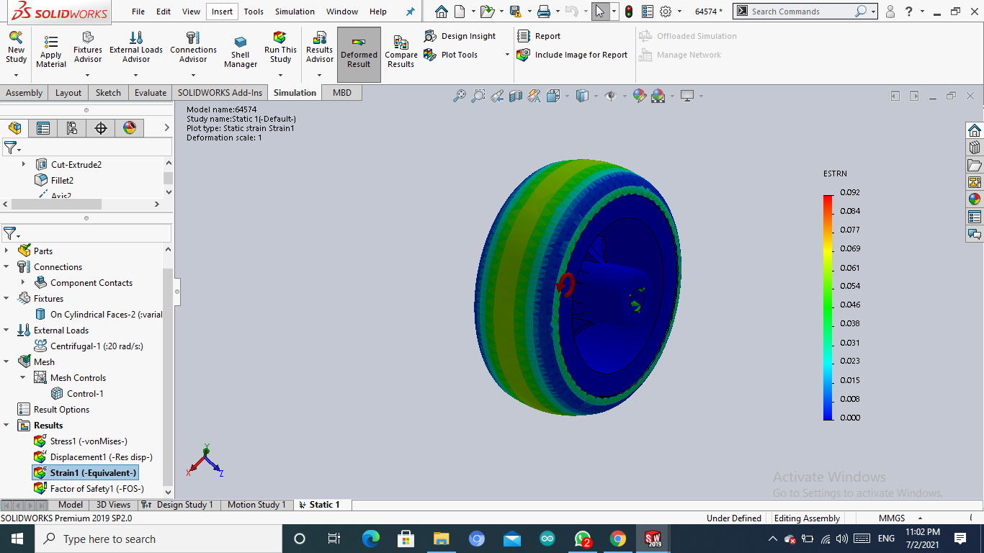
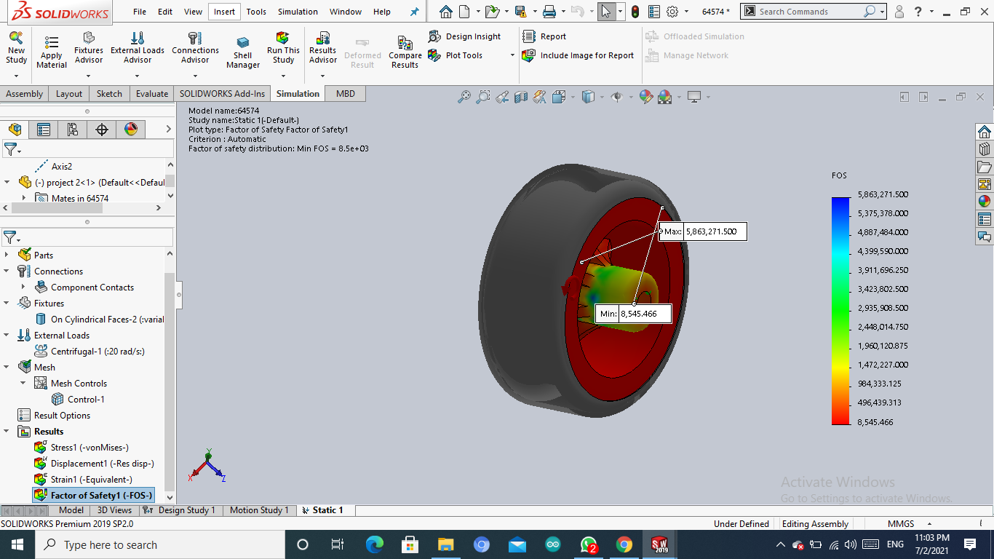

Slide 12

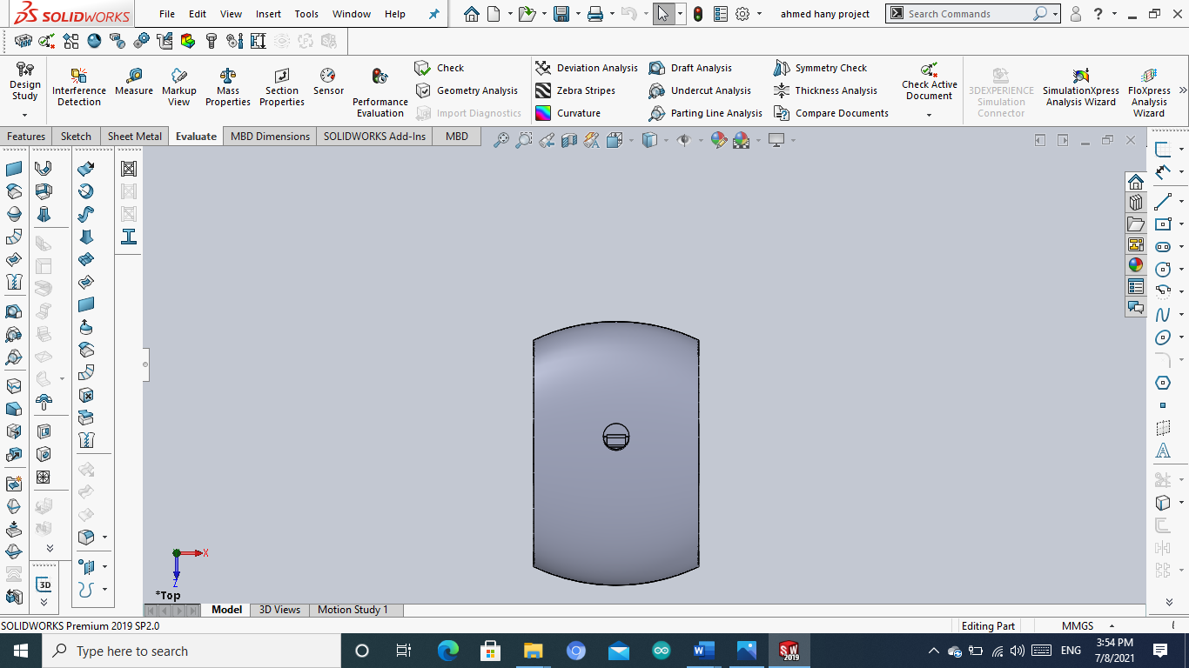
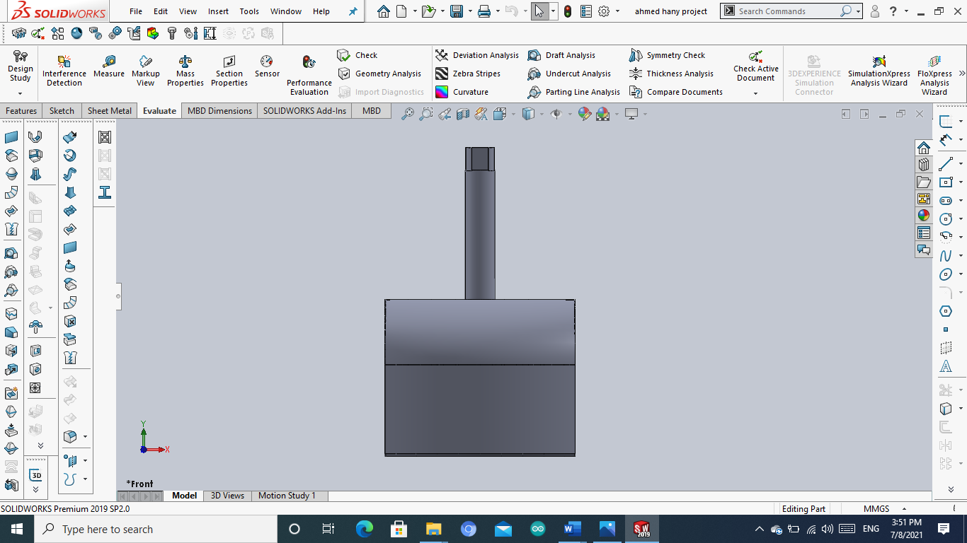
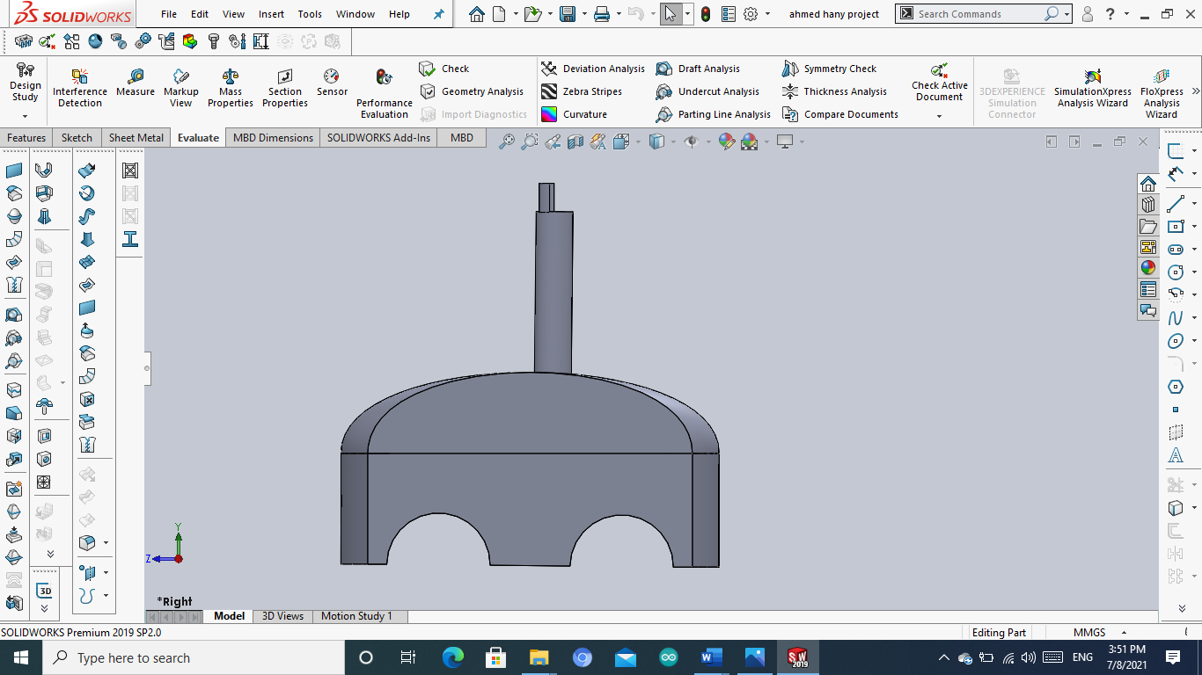

Slide 13
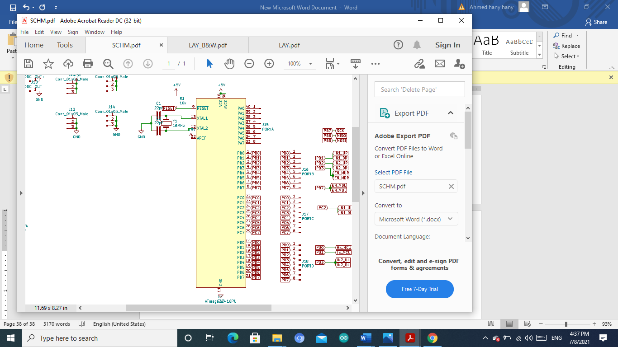
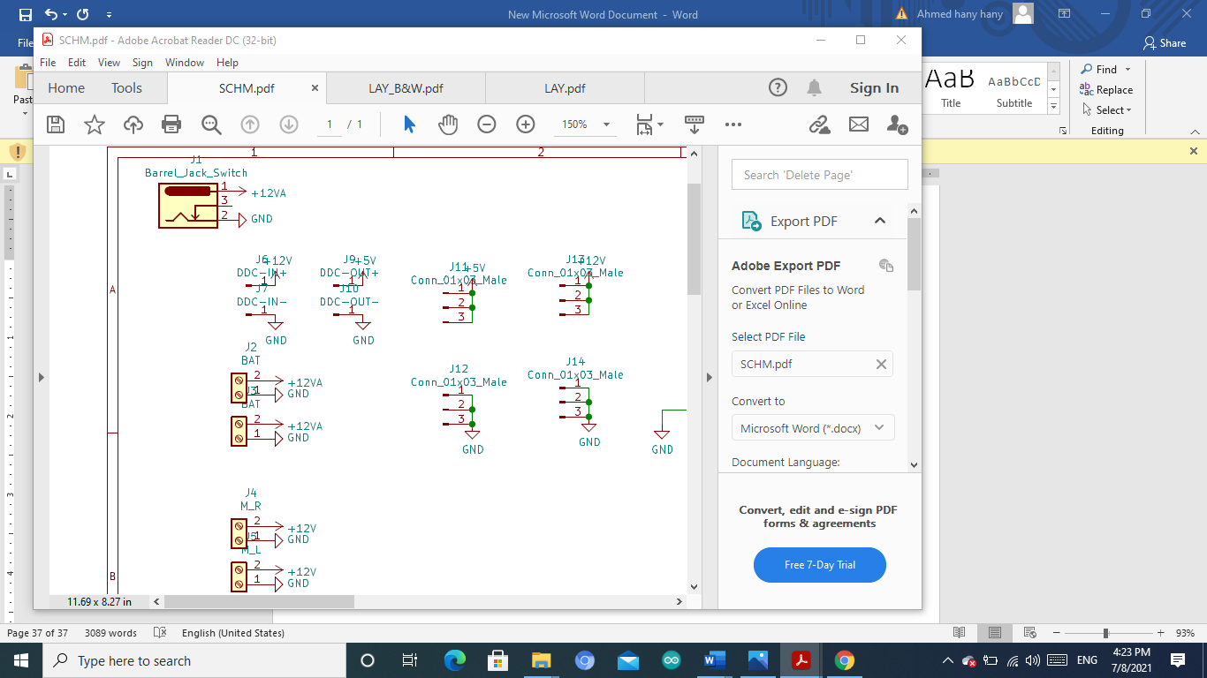
PCB DESIGN
We design a PCB board of a single layer to our robot and divided it into organized parts.

Slide 14
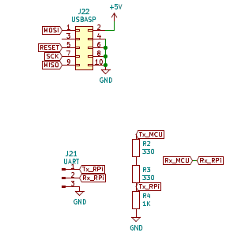

Slide 15
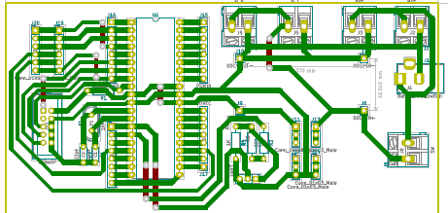
Layout

Slide 16
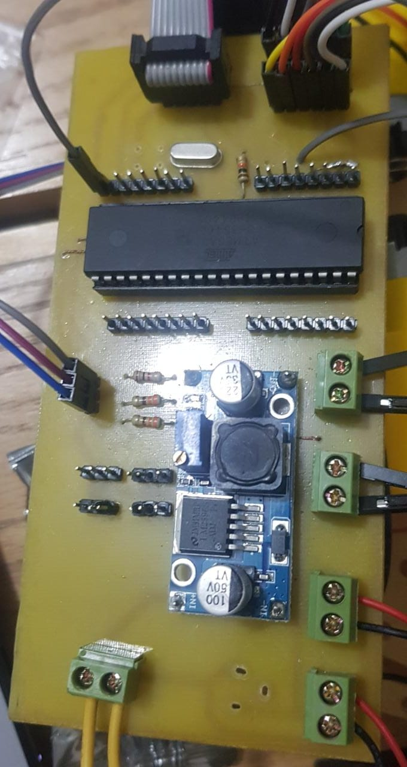

Slide 17
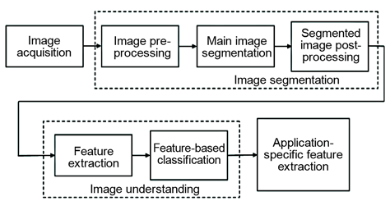
What is a computer vision?
Computer vision tasks include methods for acquiring, processing, analysing, and understanding digital images, and extraction of high-dimensional data from the real world in order to produce numerical information, in the forms of decisions. Understanding in this context means the transformation of visual images (the input of the retina) into descriptions of the world that make sense to thought processes and can extract appropriate action.

Slide 18
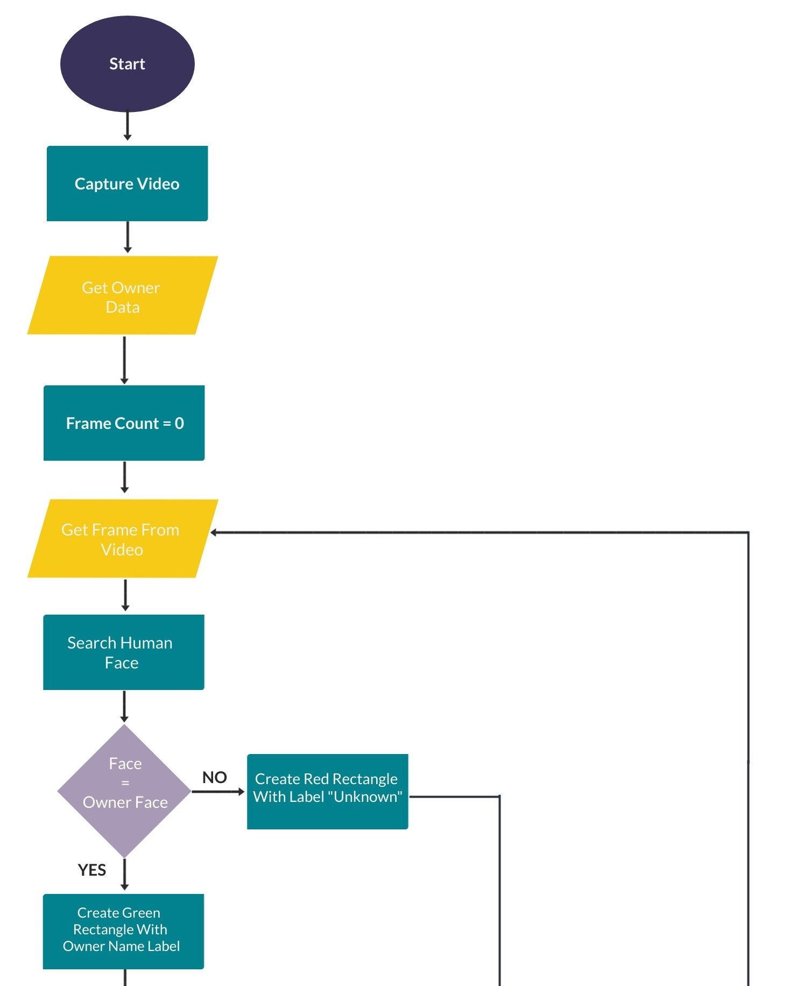
COMPUTER VISION FLOWCHART

Slide 19
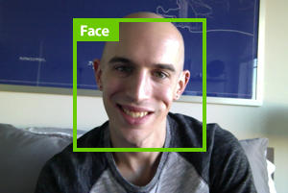
Face Sample

Slide 20
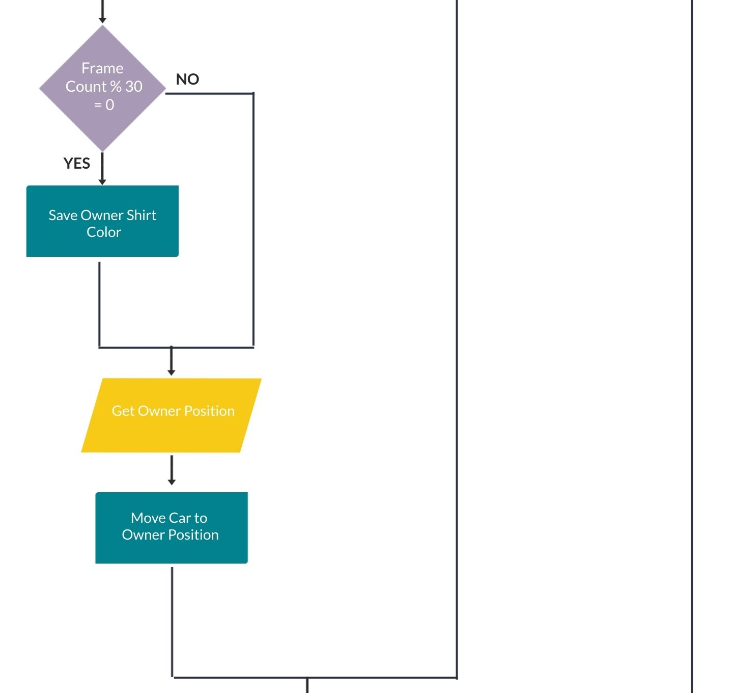

Slide 21
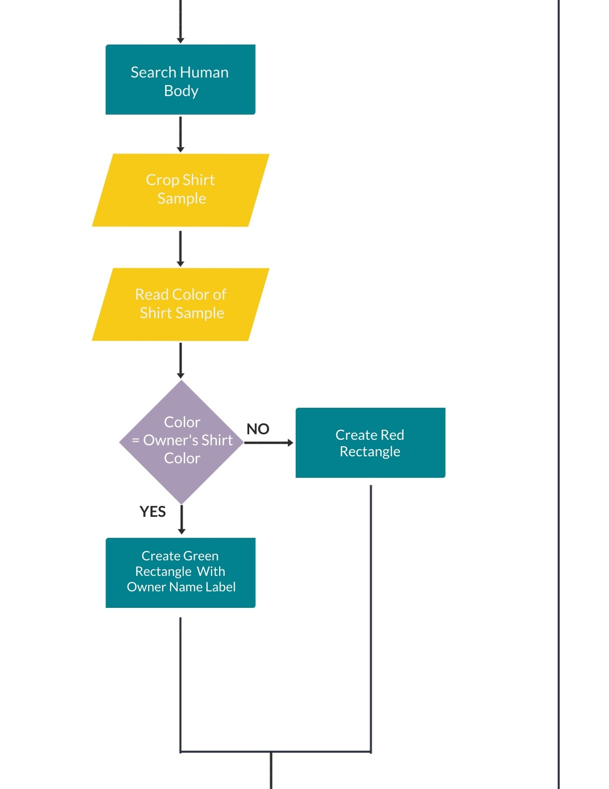

Slide 22
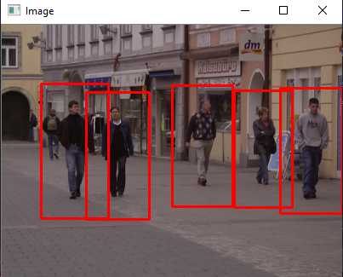
Human Body sample

Slide 23

Face Detection

Slide 24
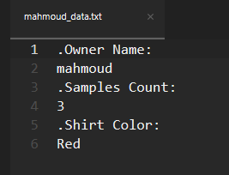
Shirt Color Saved

Slide 25
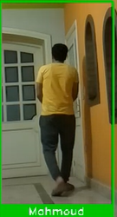
Body detection from behind

Slide 26
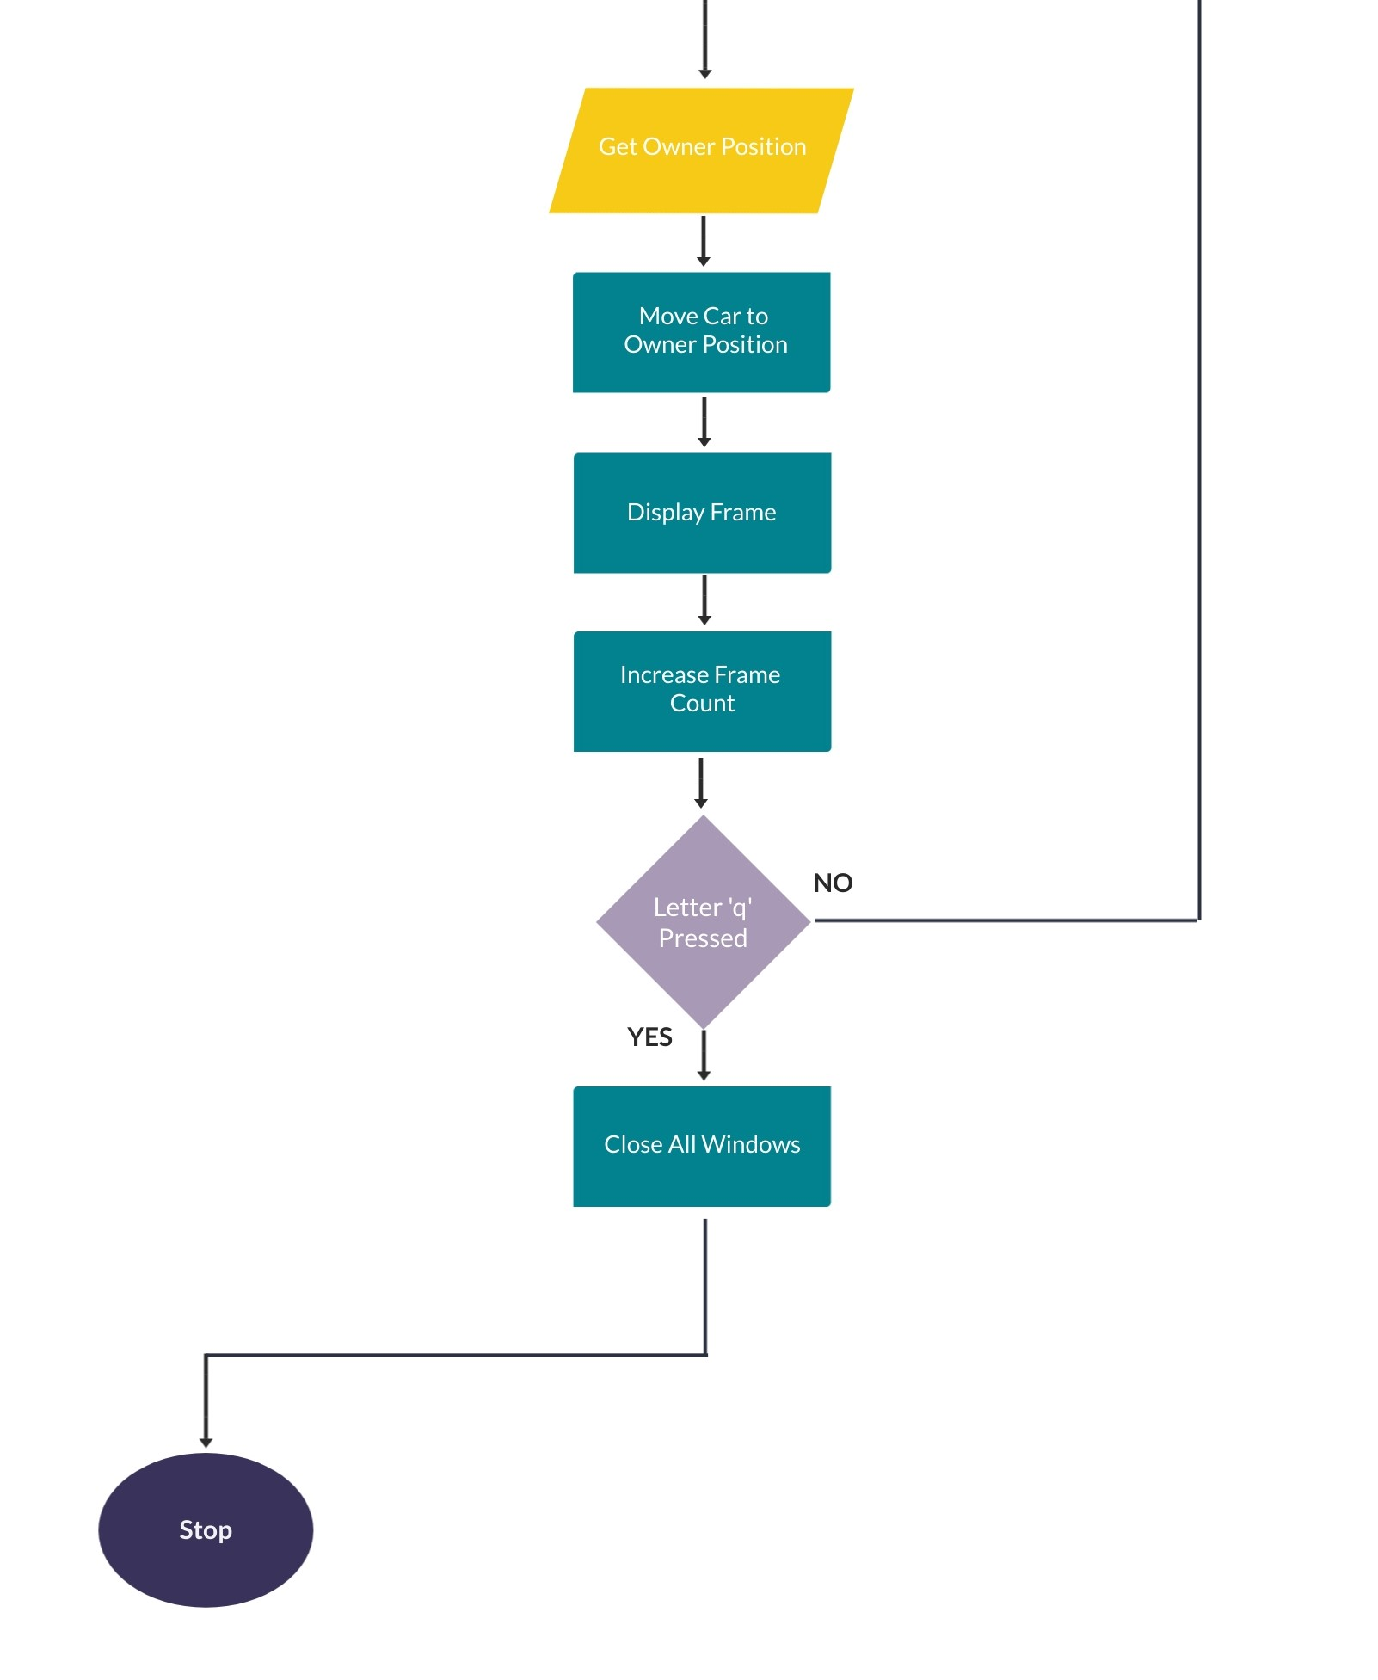

Slide 27
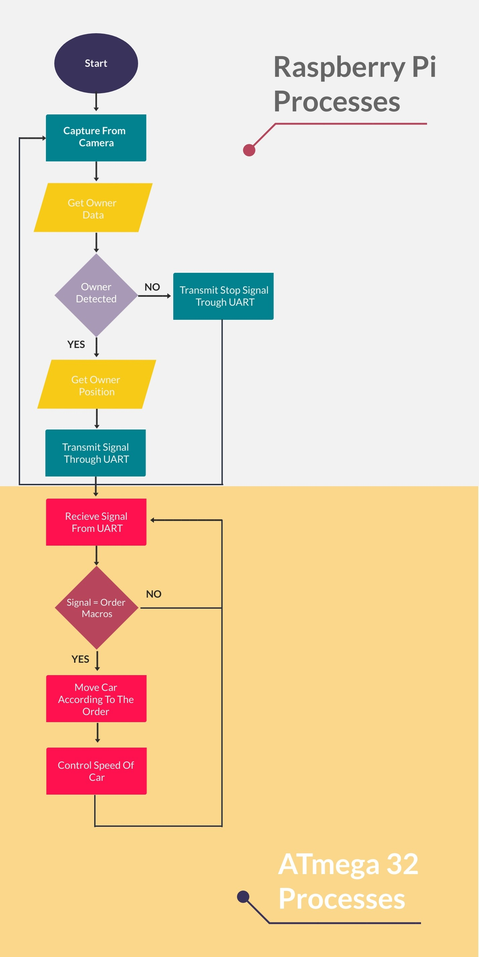
Integration flowchart

